Slide 1
Beauty Standards as Cultural Capital
How beauty standards mark social divides in five global cities:
Accra, Brussels, Buenos Aires, Hong Kong and Tehran
Giselinde Kuipers, Emmanuel Narh, Sanne Pieters, Narges Pirhayati, Carolina Rabasa Rucki, Wanying Zhou
Notes:
Thank you for coming to my talk – and thank you Michele, for inviting me.
Today, I will talk to you about beauty. Human beauty, that is: the aesthetic pleasure we derive from human appearance. Beauty plays quite a role in our lives. I would like all of you to briefly consider how much time you have spent on your appearance today and in the last week; and how much money you have spent on appearance; and how much thought you have given to the appearance of yourself and others today. Even though this is Harvard, which I suppose means that we are all brain, I assume the amount of time, money, and thought will not be trivial. We care about beauty. And we are right to care about it – because even though it might sound like a frivolous topic, it has serious consequences.
Now let’s look at Didier, from Paris. Didier cares about beauty
Chiara and Didier represent the two pillars of what I call the
A study conducted among over 93,000 people in 93 countries found that women spend an average of 238 min a day (approximately 4 h) enhancing their attractiveness though bathing, exercise, shaving, clothing, styling and make-up, against 215 min a day (approximately 3.6 h daily) for men. Marta Kowal, Sorokowski, P., Pisanski, K., et al. (2022) Predictors of enhancing human physical attractiveness: Data from 93 countries, Evolution and Human Behavior, 43(6), 455-474

Slide 2
Understanding Beauty and Inequality
Theoretical: From beauty as aesthetic capital to beauty standards as cultural capital
Methodological: How we designed a comparative study of beauty standards
Empirical: How beauty standards mark cultural divides in five global cities

Slide 3

Beyond aesthetic capital
Existing approaches to beauty and inequality (and common wisdom) typically assume or suggest consensus on beauty standards or "the beauty ideal".
This assumption suggests that beauty is a form of aesthetic capital (aka beauty premium, pretty privilege): a convertible resource or asset with measurable impact on life chances.
(e.g. Hakim, 2011; Hamermesh, 2011; Jaeger, 2011; Vandebroeck, 2016,
Widdows, 2018; Gupta et al., 2016; Sarpila et al., 2022).

Slide 4
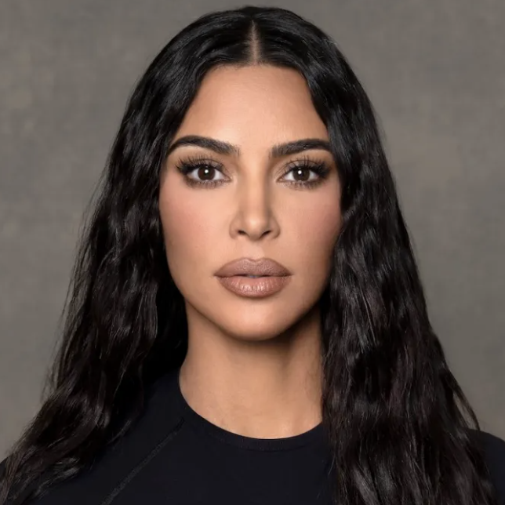
Global aesthetic capital?
Many scholars studying beauty (and inequality) suggest that beauty standards are similar across countries, either because
1) beauty standards have a universal biological basis
2) beauty standards are converging in global visual culture
1) e.g. Etcoff, 2011; Hakim, 2011; Foo et al., 2017; Gupta et al., 2019
2) e.g. Jones, 2010; Jha, 2015; Widdows, 2018

Slide 5
Beauty standards as cultural capital
We hypothesize that both beauty standards and consensus about beauty standards vary across time, place, and trait.
When people disagree on aspects of beauty, and the taste of some people has more status/legitimacy, beauty standards function as cultural capital. In such cases, beauty taste is a resource that re/produces inequalities through the drawing of symbolic boundaries.
(cf. Mears, 2011; Kuipers, 2015.
For symbolic boundaries, Lamont 1992 Lamont et al. 2014)

Slide 6
Understanding Beauty and Inequality
Theoretical: From beauty as aesthetic capital to beauty standards as cultural capital
Methodological: How we designed a comparative study of beauty standards
Empirical: How beauty standards mark cultural divides in five global cities

Slide 7
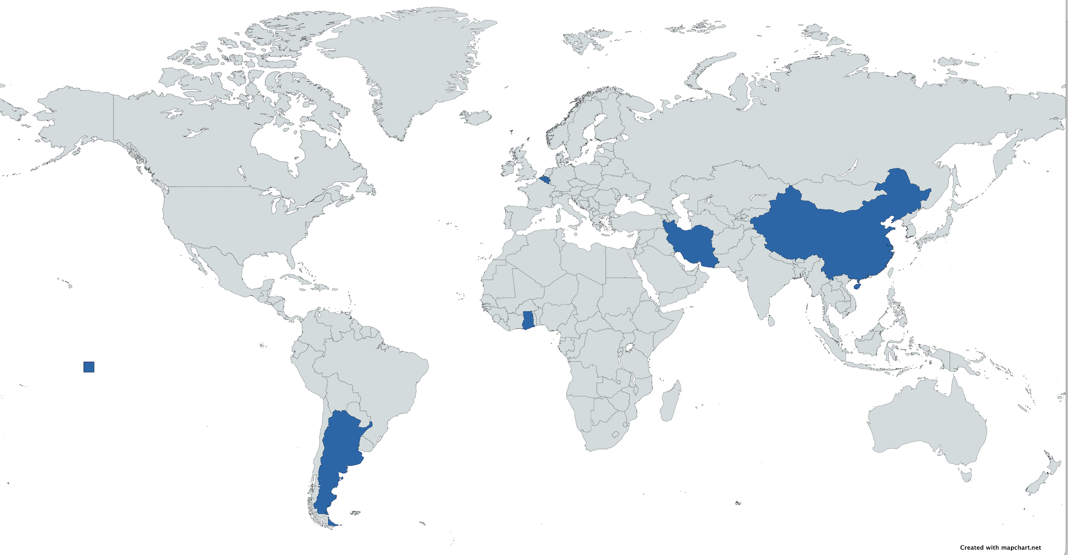

Slide 8
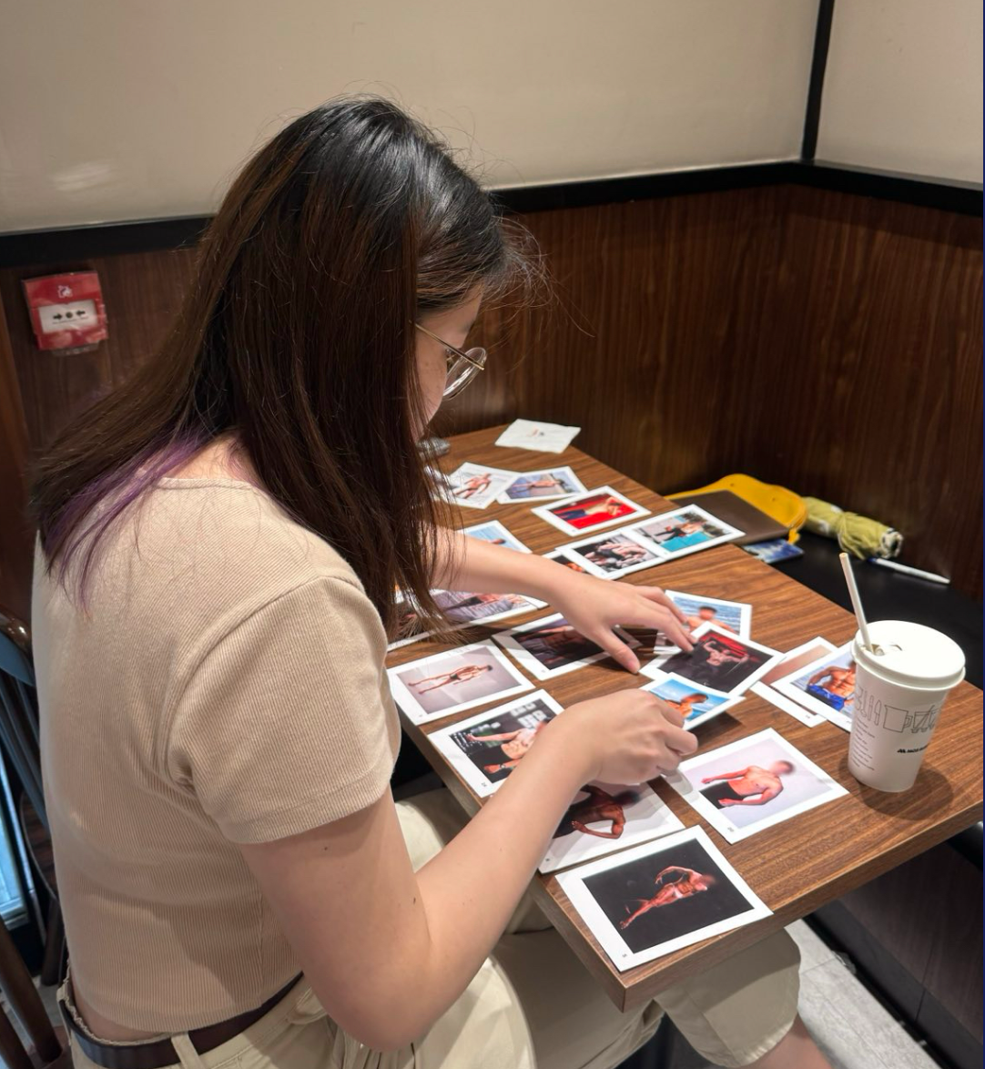
Data and method
200 semi-structured interviews with visual Q-sort
4 Q-sorts
25 diverse images of female and male faces and bodies
Open questions on beauty, beauty practices, social background
Quota sample
5 cities: Accra, Brussels, Buenos Aires, Hong Kong, Tehran
Equal proportions: college/non-college educated; men and women (+3rd gender group); 3 age groups (18-30; 31-50; 50+); religion; localition
Data analysis
Quantitative analysis of Q-scores (descriptives, factor analysis)
Thematic coding of interview transcripts
(For extensive description of method, see
Kuipers, Sezneva & Halauniova, 2022)

Slide 9
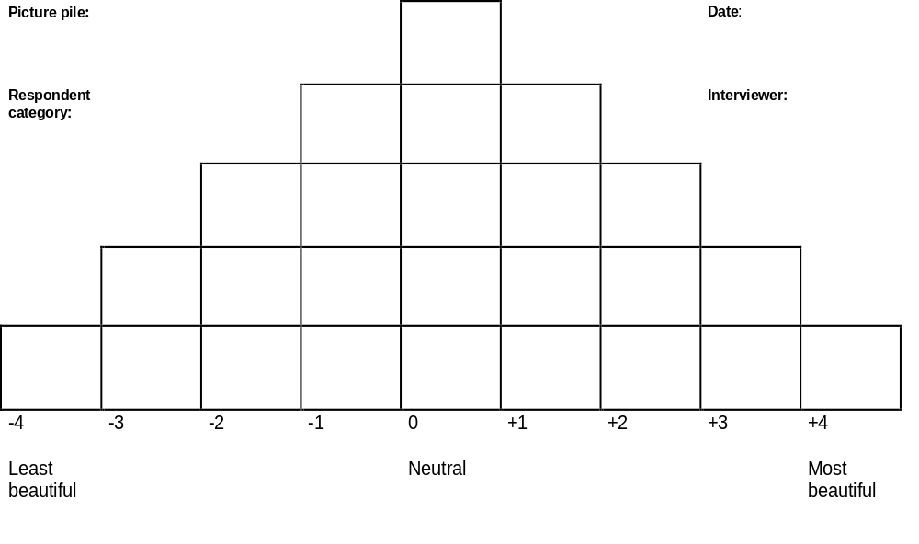

Slide 10
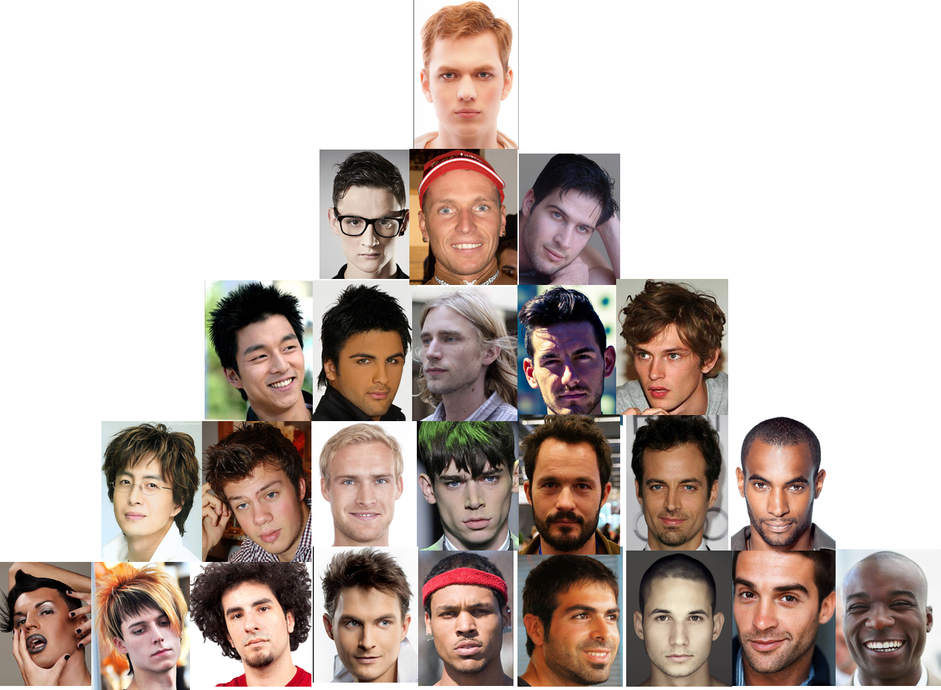

Slide 11
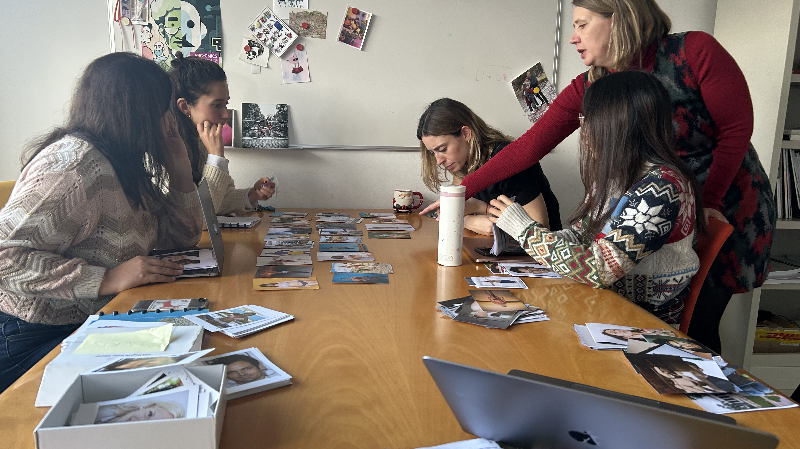
Constructing Q-sorts: a collective, iterative process
Notes:
Please explain here: the composition of the team is part of the method!!!

Slide 12
Designing a contextual comparative study
1. Co-design with a global team
2. Co-develop matrix with beauty traits (Van der Laan & Kuipers, 2016)
  24 for faces (eg., hair color, shape, gender normativity, style of photography, eye color, skin tone, eye contact, expression, smile)
  14 for bodies (eg., size, shape, gender normativity, shape of tummy, skin tone, pose, size of breast, etc.)
3. Create separate stacks (with stock photos) for each city: a mix of overlapping (shared) images and local images with common physical types and local styles and standards for each city

Slide 13
Understanding Beauty and Inequality
Theoretical: From beauty as aesthetic capital to beauty standards as cultural capital
Methodological: How we designed a comparative study of beauty standards
Empirical: How beauty standards mark cultural divides in five global cities

Slide 14
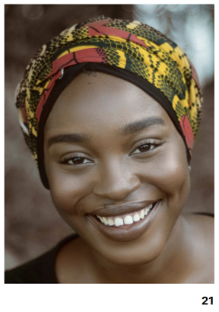
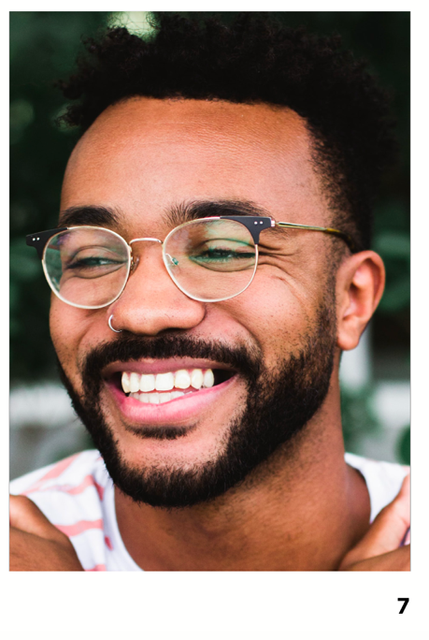
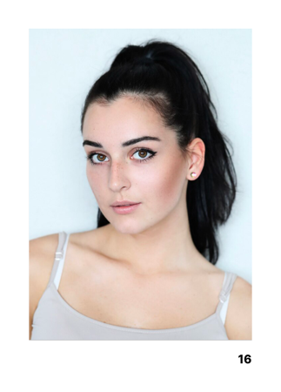
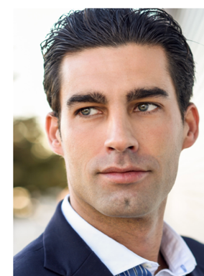
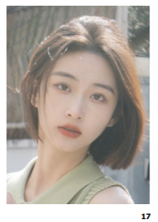
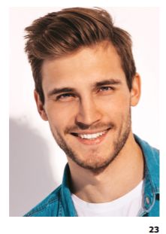
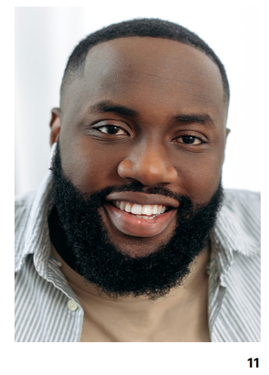
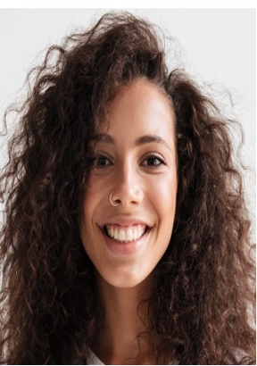
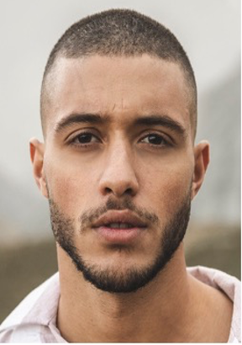

Slide 15
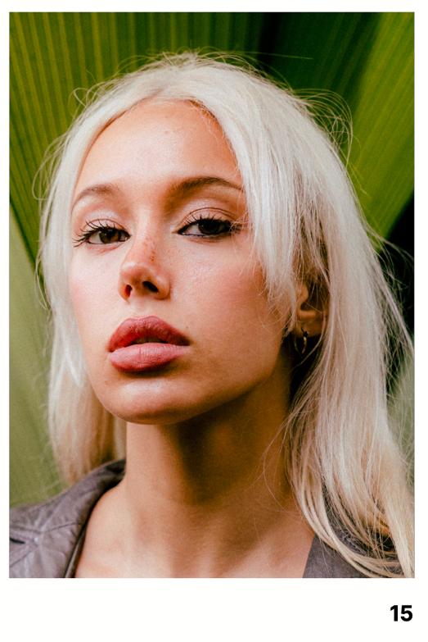
Brussels: Education/social class
"I find her eyes, her eyelashes, her nose too plastic. (...) It's been worked on too much. Of course, authenticity plays a big role there. (...) I find it less attractive in general (...) because I'm more interested in authenticity than in an ideal of beauty purely for the sake of appearance." (M, 49, media exec, Belgian, BA)
"She has something but the problem is you don't know if it's botox or not. I don't know if it's all natural or not. If it's all natural, it's not bad at all… It's a shame because there's something in her look, in the eyes, that I like. But it looks unnatural. I have mixed feelings. She has to be in my top three but how would I explain?"
(M, 50, musician, Tunisian-Belgian, BA)
"Well, you know, it looks as if she’s had work done to her face, she’s gotten her nose done and gotten botox injections and something to her lips as well. But… it suits her. I also think there is a certain charm in the way she looks. I think she’s a beautiful girl." (F, 30, Belgian-Italian, Administrative Assistant & nail stylist, Evening school)

Slide 16
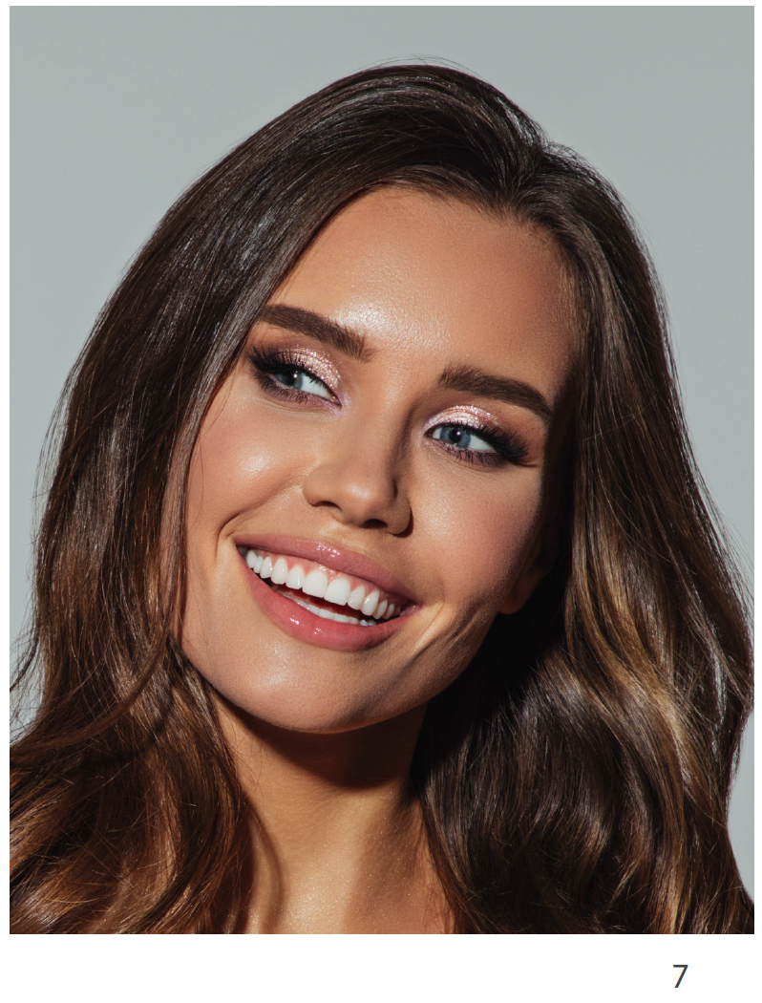
Buenos Aires: Education/social class
"I'm going to put it in less beautiful, because there's also something that I feel in particular with the FF7 image. I think it also goes a bit hand in hand with beauty associated with makeup, right? For example, unlike the other images, she's wearing makeup… and I I don't know if there is any aesthetic surgery in there. (...) so in that sense for me the FF7 is less beautiful, because I don't feel it natural... I mean, I also love to wear makeup and everything." (F, 30, acting teacher, college, low economic capital, high cultural capital)
"The FF7 image which is the one I put as the most beautiful, it seems to me that she has a much more defined face, with marked features, lighter eye color, a smile, I would say almost perfect, eyebrows… she is a very neat and very groomed woman, a lot of facial harmony." (M, 18, laborer, lower class)

Slide 17
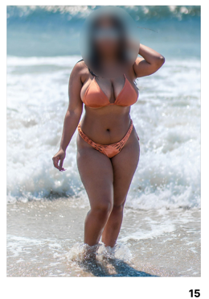
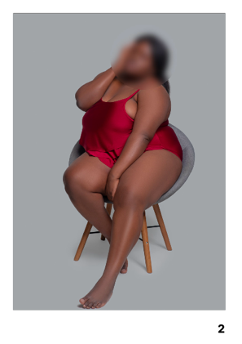
Accra: Education/"westernization"
“A beautiful woman in Ghana should not be ‘too skinny’ nor ‘too fat’. [I: So like no 5?] No, she is too skinny. It should be like no 15, you know, she should have flesh, soft to touch with smooth skin, should be curvy. Ahuh... We don’t want to be too fat or too skinny”
(F, 30, Nurse, MA degree)
FB 15
“I like number 2. To be honest my boyfriend like this body type and this is how I look like.
That is why I choose the number 2 as my most beautiful. I have big butt, dark in complexion,
big breasts, big hips. Oh that is me.”
(F, 20, Saleswoman, High school degree)

Slide 18
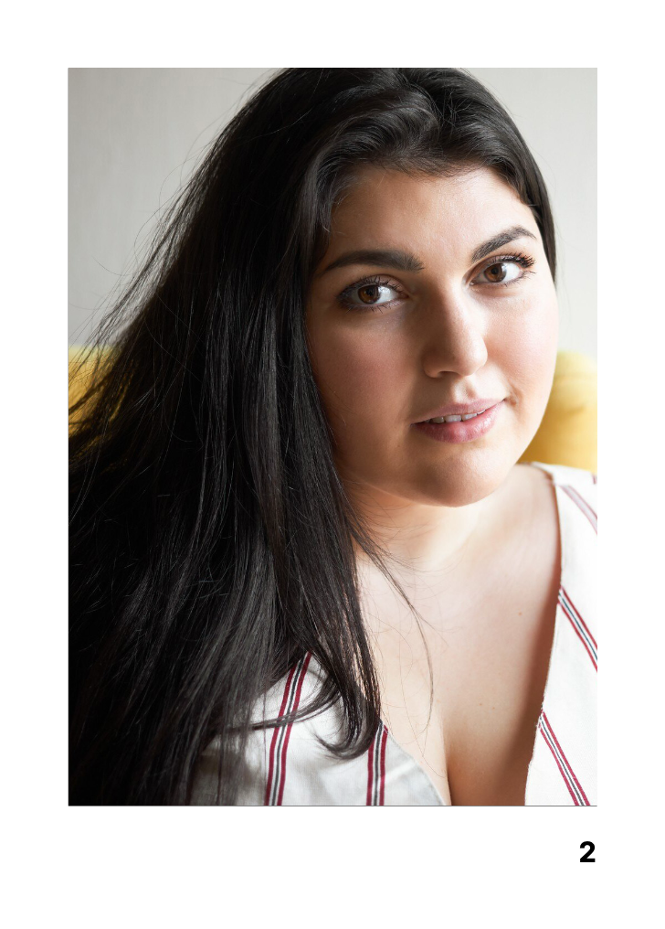
Tehran: Religion/age
“Yes, just like I said, her face is round — I mean, her buccal area is too full. . . When you smile, this part shouldn’t be chubby next to your smile, because it makes the face look fat . . I don’t like this type of eyebrow because they’re both short and thin. Then her eyes — it seems like she has puffiness around the eyelids. I prefer that area to look more flat and clean. As for her nose, it’s not big, but because it lacks a proper curve, it looks a bit off. And her upper lip is also a bit small… it doesn’t feel very feminine. To me, femininity means having more prominent features — like fuller cheeks, plump lips, thick eyebrows — those are more feminine.” (F, 23, medical student, non-religious)
“Her eyes are beautiful — she has a kind look in her face, especially in her eyes. She has a full face, which I like. . . . She’s simple-looking, and I see that as a positive thing too. She has nice hair, and her eyebrows are good — not bad. The brow arch is a bit sparse in my opinion; if it were fuller, it would match her eyes better....Her lips are also good...But overall, when you look at her, she gives off an innocent vibe — that’s what I liked. Mostly it’s the expression in her eyes that makes her seem cute to me.”
(F, 33, housewife, high school, moderately religious)

Slide 19
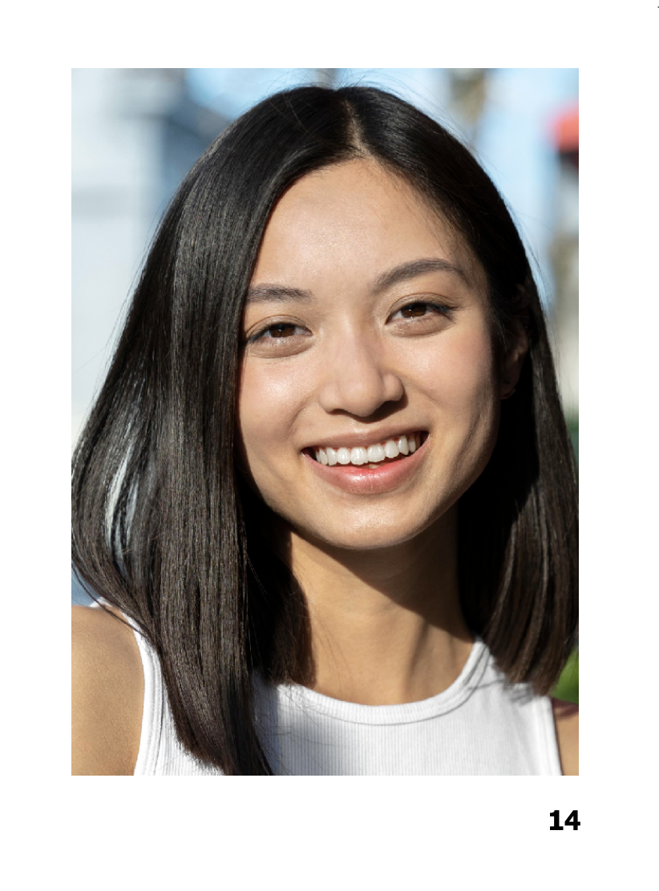
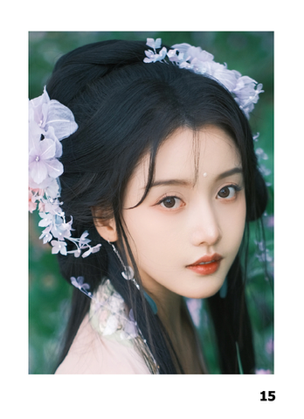
Hong Kong: ethnicity/migration (+ politics)
"I like women who look natural. Not looking like men, not with heavy makeup. I look into her eyes. She looks sincere. Naturalness is the most important thing. That’s how I’d choose my partner." (M, 63, retired engineer, Hong Kong origin)
"No. 15 looks Qingchun [innocent and pure]. Her face features are nice-looking, big eyes, pretty face shape. To my own feelings, I like the Qingchun look."
(F, 52, service staff at a student canteen, mainland immigrant)

Slide 20
When do tastes become cultural capital?
When there is a hierarchy
When a taste is consecrated as legitimate
To some extent: When a taste is hegemonic, that is: when it becomes accepted even as legitimate by those who don't share it
There may also be different constellations of taste cultures,
e.g. horizontal diversity, struggle ("culture war"), etc.
(Kuipers, 2006; Lamont 2000; Lamont et al. 2014)

Slide 21
Conclusion:
How beauty standards mark social divides
No (full) consensus within and across cities on who/what is beautiful and why.
Physical beauty is a domain where (multi-layered, intersecting) social identities are expressed and divides marked.
In different places, different differences are salient.
But are beauty standards cultural capital?
Sometimes clearly yes: hierarchical, legitimate, hegemonic
Sometimes less clear: horizontal, hegemony contested or absent

Slide 22
Next steps
More analysis
  Detailed mixed-method analysis of every city
  Comparative analysis and collective write-up
  Design global Q-set with selected images from the 5 Q-sets, and survey (in four countries/cities, Iran is not feasible)
More theoretical avenues
  History and working of "different differences" across places
  Cultural capital and other forms of boundary drawing
  Relation between beauty standards and transnational inequalities
  When, how and why are beauty standards mobilized and activated for
  (social, cultural, and increasingly: political) distinction?
  And whose beauty?

Slide 23

This presentation is part of project that has received funding from the European Research Council (ERC) under the European Union’s Horizon 2020 research and innovation programme, Grant agreements No. 101052649.
Views and opinions expressed are however those of the author(s) only and do not necessarily reflect those of the European Union or the European Research Council Executive Agency. Neither the European Union nor the granting authority can be held responsible for them.

Slide 24



Thank you! Questions? sociologyofbeauty.eu
✉️ giselinde.kuipers@kuleuven.be giselinde.kuipers@bsky.social

